Slide 1
Android Networking – Part 1
Minstrel Chiu
minstrelsy@gmail.com

Slide 2
Outline
Required Permissions
HTTP Networking
Threads & Parallelism
Socket Networking

Slide 3
Required Permissions (1)
Sample-Permission1 – Permission required demo

Slide 4
Required Permissions (2)
android.permission.INTERNET (mandatory)
android.permission.ACCESS_NETWORK_STATE (optional)

Slide 5
HTTP Networking (1)
URL (Android Native)
HttpURLConnection (Android Native)
OkHttp (Square)
Deprecated
HttpClient, AndroidHttpClient (Apache)
No New Features
Volley (Google)

Slide 6
HTTP Networking (2)
URL – RFC 2396 & RFC 2732
http://www.example.com:1080/docs/resource1.html?s=test&k=123
Protocol – http
Host – www.example.com
Port – 1080
Path – /docs/resource1.html
File – /docs/resource1.html?s=test&k=123
Query – s=test&k=123
Sample-URL-1 – URL parsing demo

Slide 7

HTTP Networking (3)
HttpURLConnection GET
Instantiate a object of URL class
Call openConnection method
Call connect method
Read website contents from InputStream
Release the connection by disconnect

Slide 8
HTTP Networking (4)
HttpURLConnection Extras
Connection Timeout – setConnectTimeout
milliseconds
Read Timeout – setReadTimeout
Milliseconds
Do Output – setDoOutput, default is false
Request Method – setRequestMethod, default is GET
GET/POST/PUT/DELETE/HEAD/OPTIONS
Get Response Code – getResponseCode
1xx/2xx/3xx/4xx/5xx

Slide 9
HTTP Networking (5)
Sample-Http-1 – HttpURLConnection GET demo

Slide 10
HTTP Networking (6)
HttpURLConnection POST
setDoOutput(true)
new Uri.Builder().appendQueryParameter(param1, value1).build().getEncodedQuery();
Write to OutputStream and then read from InputStream

Slide 11
HTTP Networking (7)
Sample-Http-2 – HttpURLConnection POST demo

Slide 12
HTTP Networking (8)
OkHttp GET – Much easier than HttpURLConnection
Import latest OkHttp lib in build.gragle
Instantiate an OkHttpClient object
Create a Request
Execute a newCall and get Response

Slide 13
HTTP Networking (9)
Sample-Http-3 – OkHttp GET demo

Slide 14
HTTP Networking (10)
OkHttp POST– Much easier than HttpURLConnection
RequestBody body = new FormBody.Builder().add(param1, value1).build()
Request request = new Request.Builder().url(url).post(body).build()

Slide 15
HTTP Networking (11)
Sample-Http-4 – OkHttp POST demo

Slide 16
Threads & Parallelism (1)
Sample-Thread-1 – HttpURLConnection with StrictMode enabled demo
StrictMode is a developer tools and usually been disabled in real products

Slide 17
Threads & Parallelism (2)
NetworkOnMainThreadException
The exception that is thrown when an application attempts to perform a networking operation on its main thread. This is only thrown for applications targeting the Honeycomb SDK or higher. Applications targeting earlier SDK versions are allowed to do networking on their main event loop threads, but it's heavily discouraged.

Slide 18
Threads & Parallelism (3)
Main Thread
Runs application code from the queue one by one
a.k.a. UI Thread
Background Thread
Application can have many background threads
For operations to perform that are not instantaneous
a.k.a. Worker Thread
Rules
Do not block the UI thread
Do not access the Android UI toolkit from outside the UI thread

Slide 19
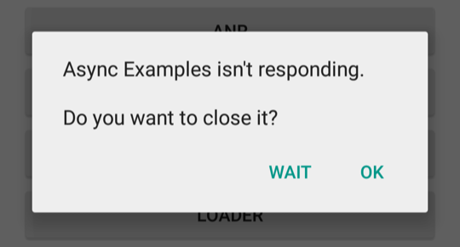
Threads & Parallelism (4)
ANR (Application Not Responding)
5 second input event timeout

Slide 20
Threads & Parallelism (5)
Thread
Thread + Handler
AsyncTask

Slide 21
Threads & Parallelism (6)
Sample-Thread-2 – HttpURLConnection on background thread demo

Slide 22
Threads & Parallelism (7)
CalledFromWrongThreadException
Only the original thread that created a view hierarchy can touch its views
The tasks that you run on a thread from a thread pool aren't running on your UI thread, they don't have access to UI objects.

Slide 23
Threads & Parallelism (8)
Sample-Thread-3 – Communicating with UI thread demo

Slide 24
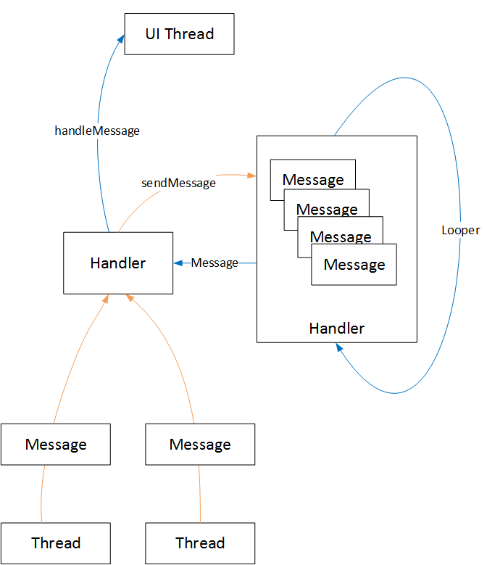
Threads & Parallelism (9)
Thread + Handler

Slide 25
Threads & Parallelism (10)
Thread + Handler
Send Message
Handler. sendEmptyMessage(int what)
Handler. sendMessage(Message msg)
Handler. obtainMessage(int what, Object obj)
Handle Message
Handler.handleMessage(Message msg)

Slide 26
Threads & Parallelism (11)
Sample-Thread-4 – HttpURLConnection with background thread and handler demo

Slide 27
Threads & Parallelism (12)
AsyncTask
AsyncTask enables proper and easy use of the UI thread. This class allows you to perform background operations and publish results on the UI thread without having to manipulate threads and/or handlers.
android.os.AsyncTask<Params, Progress, Result>

Slide 28
Threads & Parallelism (13)
AsyncTask
onPreExecute – Runs on the UI thread before doInBackground
doInBackground – Runs on a background thread, and call publishProgress to publish updates on the UI thread
onProgressUpdate – Runs on the UI thread to get progress update from publishProgress
onPostExecute – Runs on the UI thread after doInBackground

Slide 29
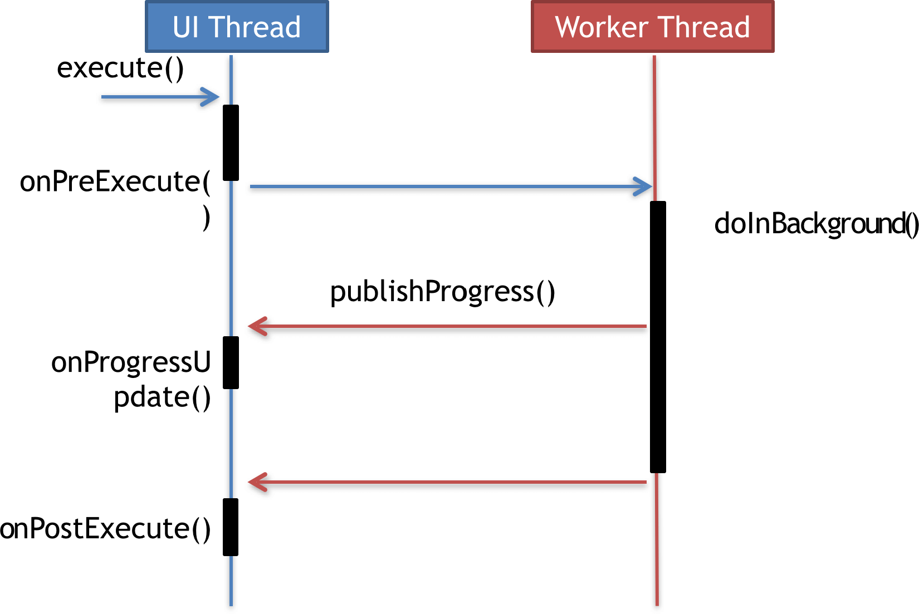
Threads & Parallelism (14)
AsyncTask
References: How To Simplify Networking In Android: Introducing The Volley HTTP Library

Slide 30
Threads & Parallelism (15)
Sample-AsyncTask-1 – HttpURLConnection with AsyncTask demo
Sample-AsyncTask-2 – OkHttp with AsyncTask demo

Slide 31
Threads & Parallelism (16)
OkHttp + Background Thread
AsyncTask
OkHttp Callback
void onFailure(Call call, IOException e)
void onResponse(Call call, Response response)

Slide 32
Threads & Parallelism (17)
Sample-OkHttp-Async-1 – OkHttp with AsyncTask demo
Sample-OkHttp-Async-2 – OkHttp with Callback demo

Slide 33
Socket Networking (1)
TCP Socket
FTP – port 20, 21
Telnet – port 23
DNS – port 53
HTTP – port 80
POP3 – port 110
UDP Socket
DNS – port 53

Slide 34
Socket Networking (2)
Socket
Instantiate a object of Socket class with address and port
Read contents from InputStream
Release the connection by close

Slide 35
Socket Networking (3)
Sample-Socket-1 – Socket demo

Slide 36
Questions?

Slide 37
References
Connecting to the Network
Processes and Threads
Communicating with the UI Thread
Keeping Your App Responsive
Udacity - Android Basics: Networking
Google Samples - android NetworkConnect

